Slide 1

Chef-2-Go
One stop platform for Recipes
-Basavaraj Patil
-Bhuvan Dama Venkatesh Raj
-Shreyas Hanamantgouda Patil
-Keerthana Mikkili
Contributors

Slide 2


Purpose of Application
Chef2go is a dedicated online platform designed using Reactjs exclusively for students, serving as a convenient all-in-one solution for culinary needs. Beyond just cooking, the platform provides students access to premium subscription videos.

Slide 3
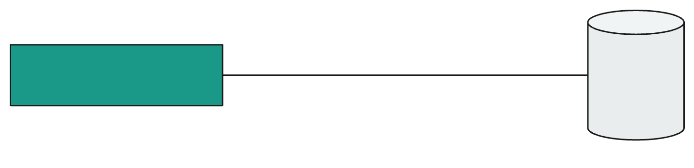

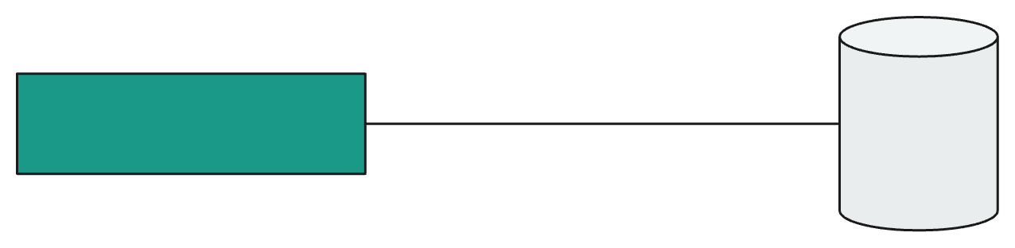




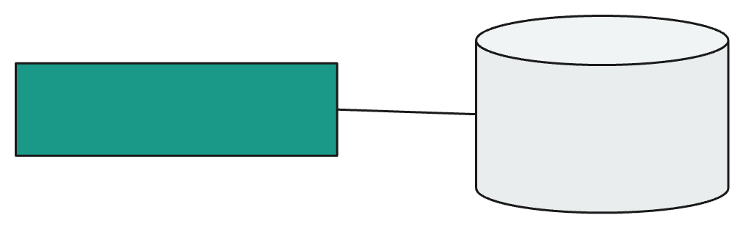




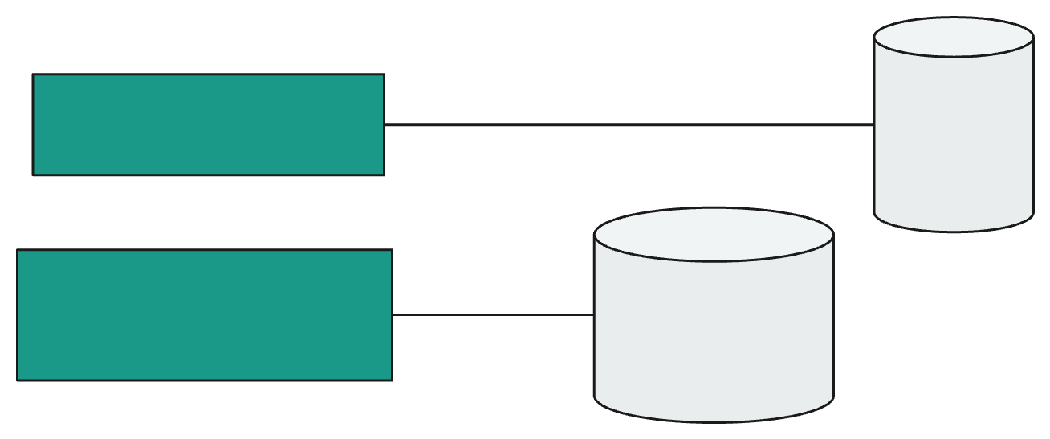



User Proﬁle
User
ChefProfile
Chef
User Device
Search By Chef
Chefs
Search By Recipes
Recipes
Premium
Videos

Slide 4

Tech Stack
React
TypeScript
MongoDB
Node.Js
Express
Tailwind
Material UI
GSAP
NodeMailer
EmailJS
Stripe
Lottie
Firebase
i18next
React player

Slide 5

Features
New user registration or Login
View and update user proﬁle
Search By Chef
Add, Update and Delete Chef
Search By Recipe
Add, Update and Delete Recipe
Premium Subscription Videos
Contact US

Slide 6
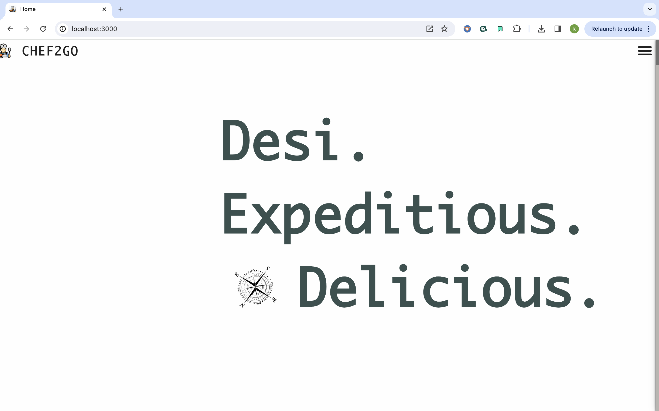
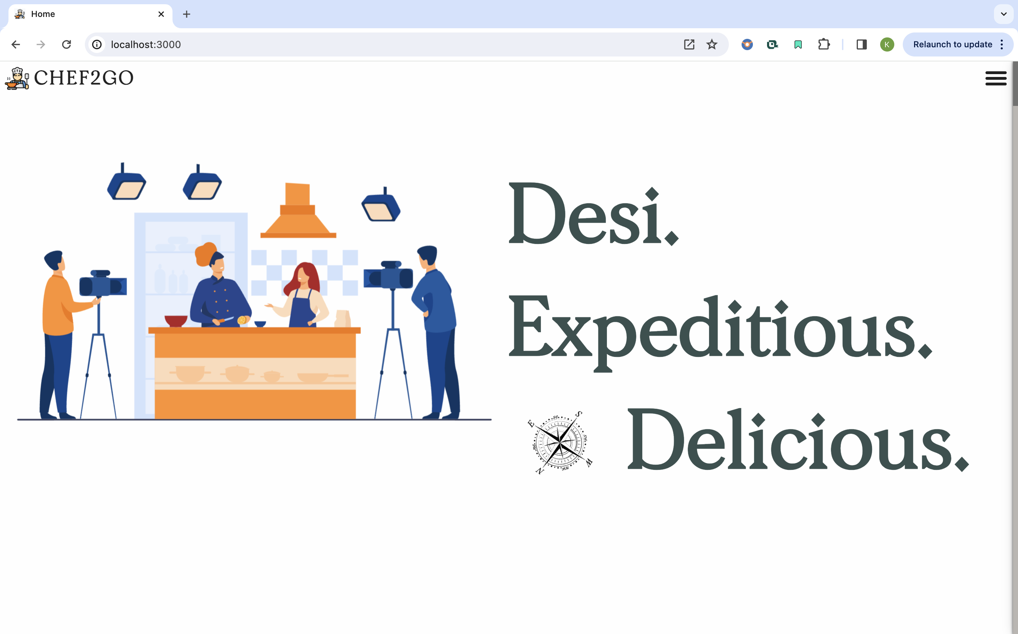
SCREENSHOTS
HOME PAGE

Slide 7
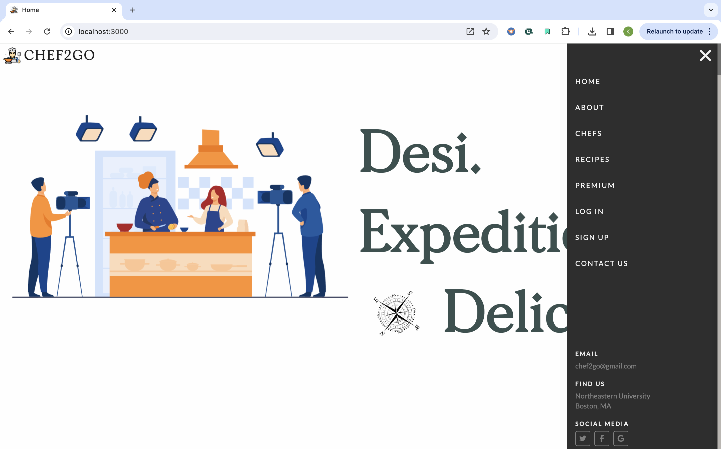
SIDE NAV BAR

Slide 8
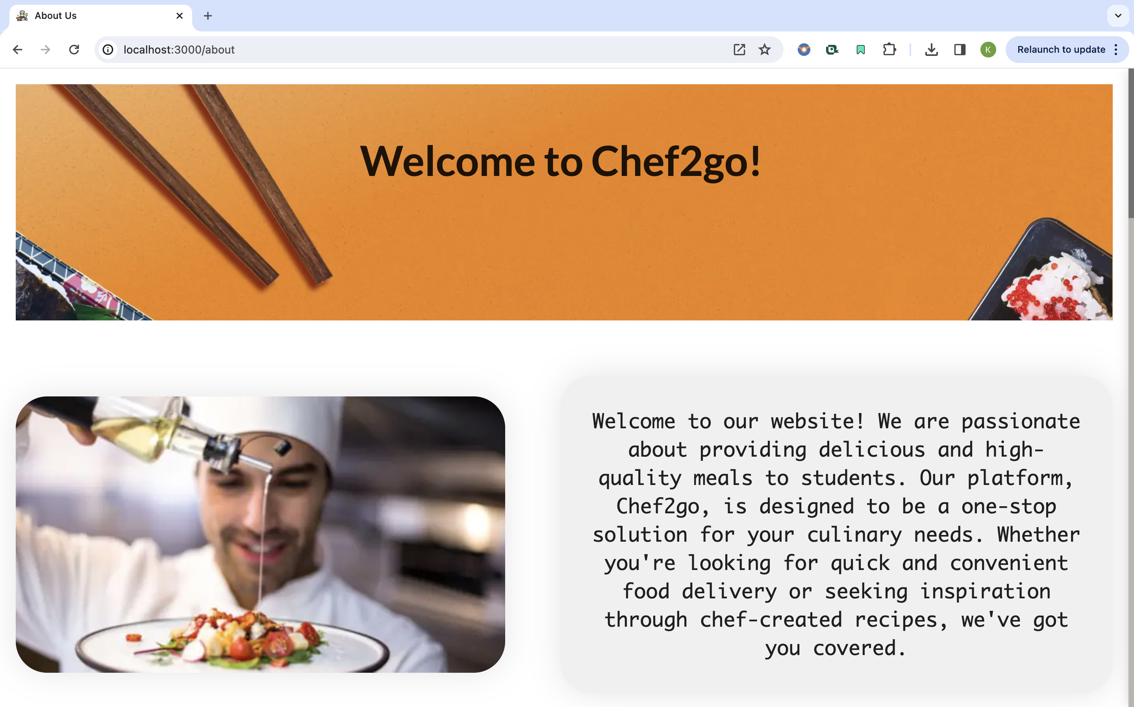
ABOUT US PAGE

Slide 9
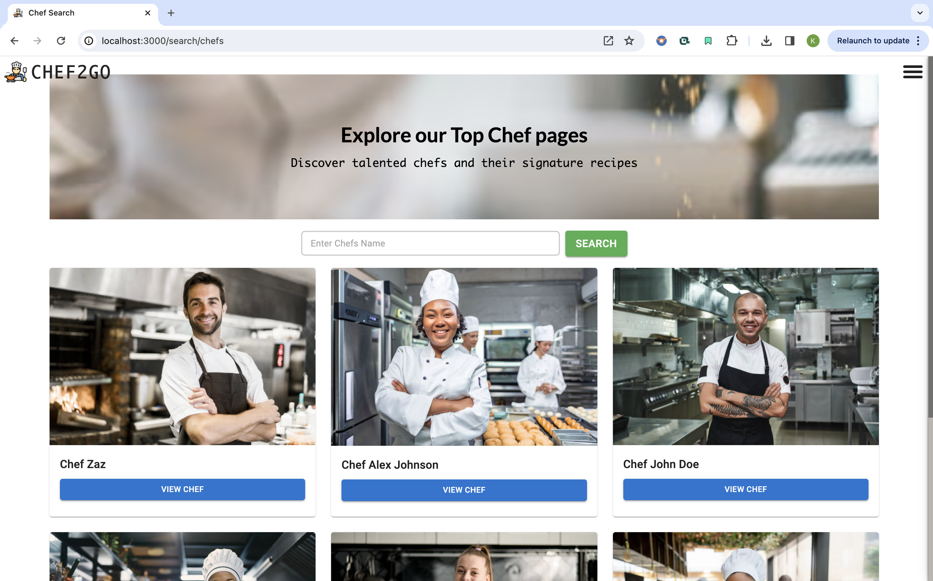
SEARCH BY CHEF PAGE

Slide 10
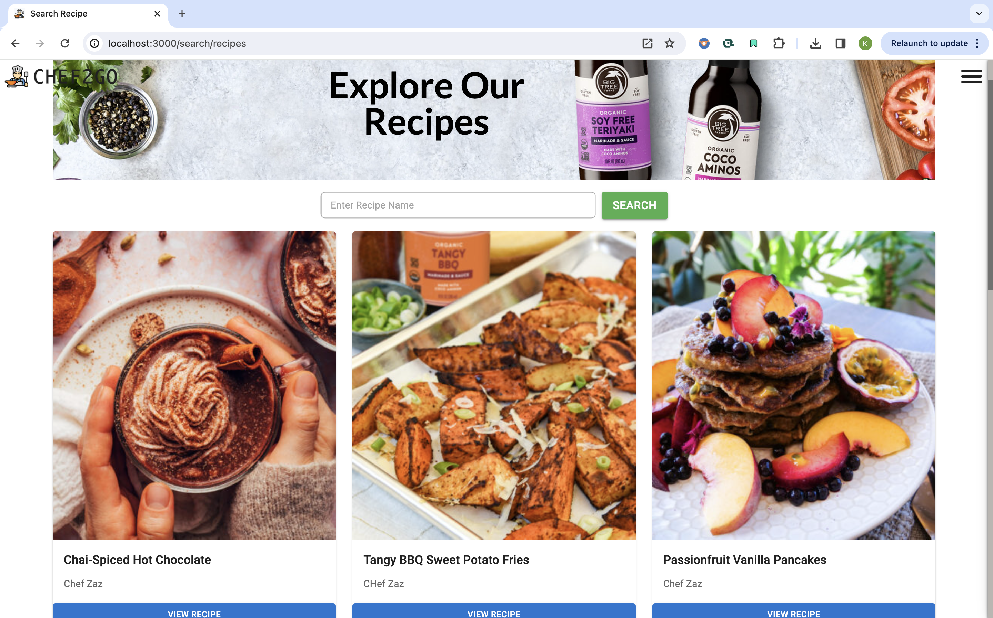
SEARCH BY RECIPE PAGE

Slide 11
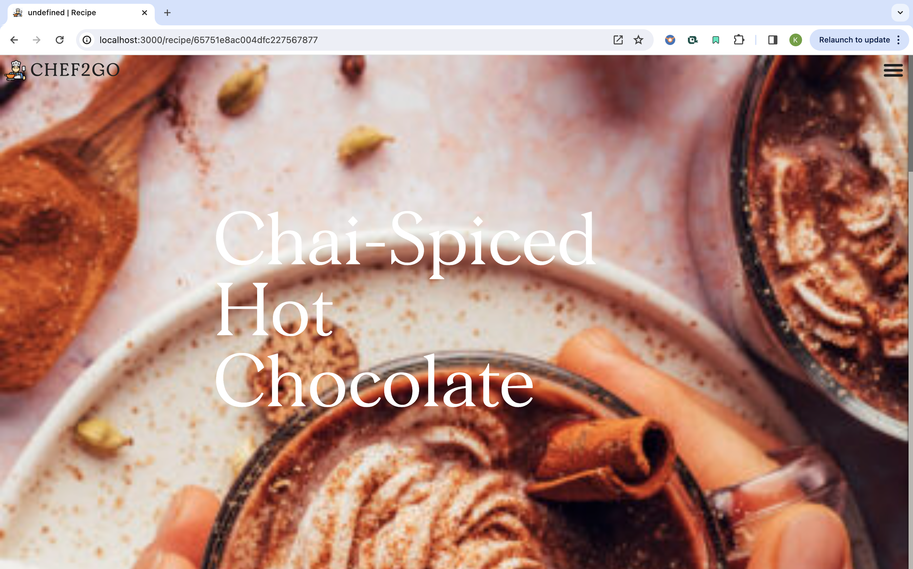
INDIVIDUAL RECIPE PAGE

Slide 12
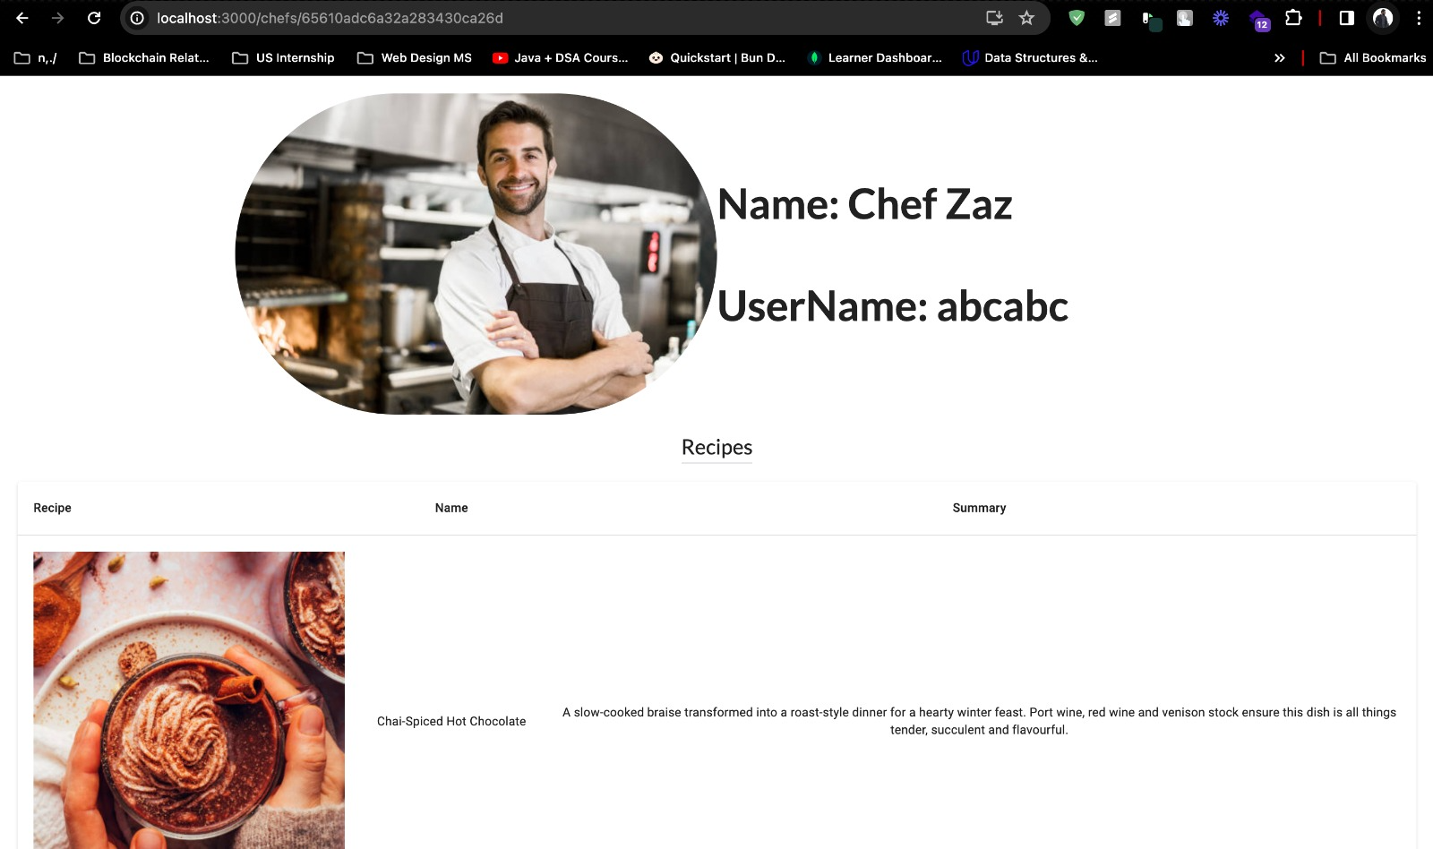
CHEF INDIVIDUAL PAGE

Slide 13
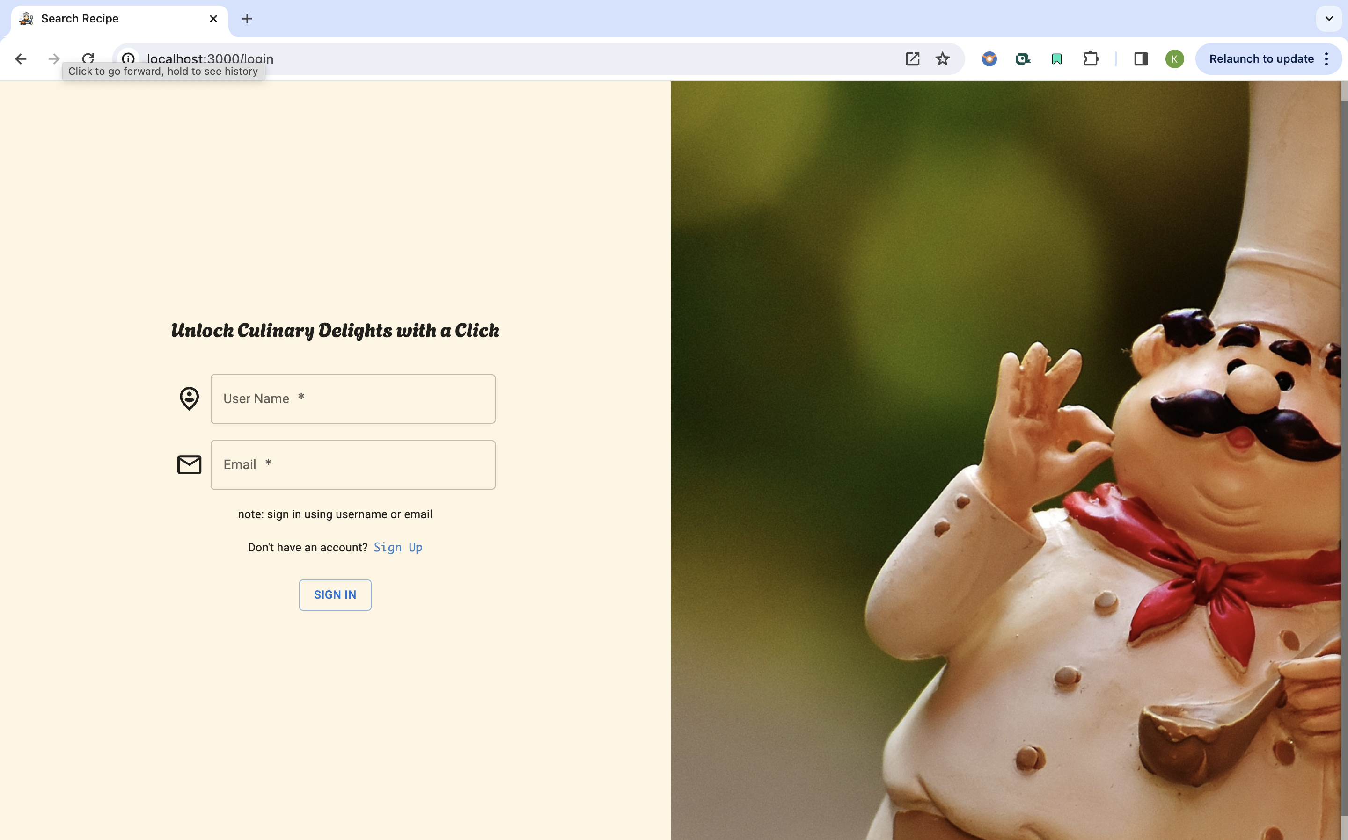
LOGIN PAGE

Slide 14
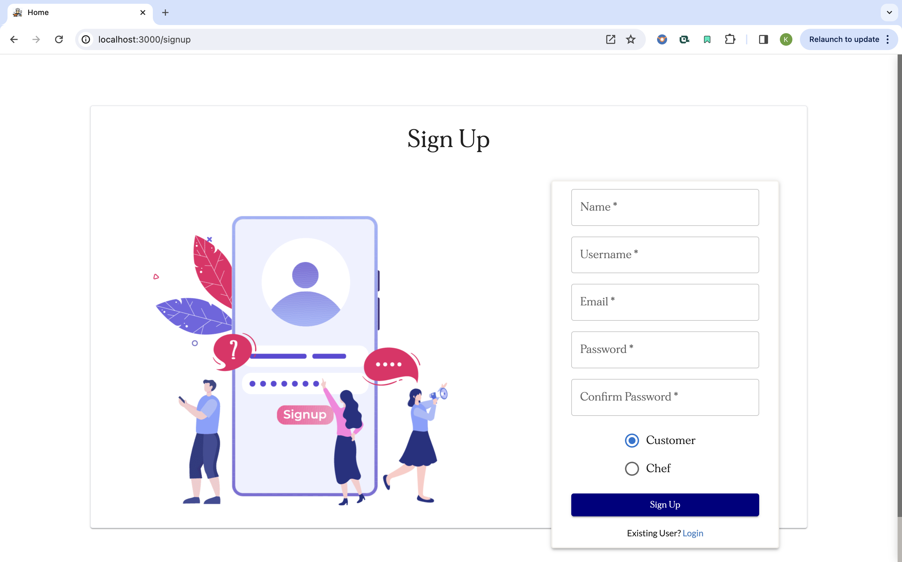
SIGNUP PAGE

Slide 15
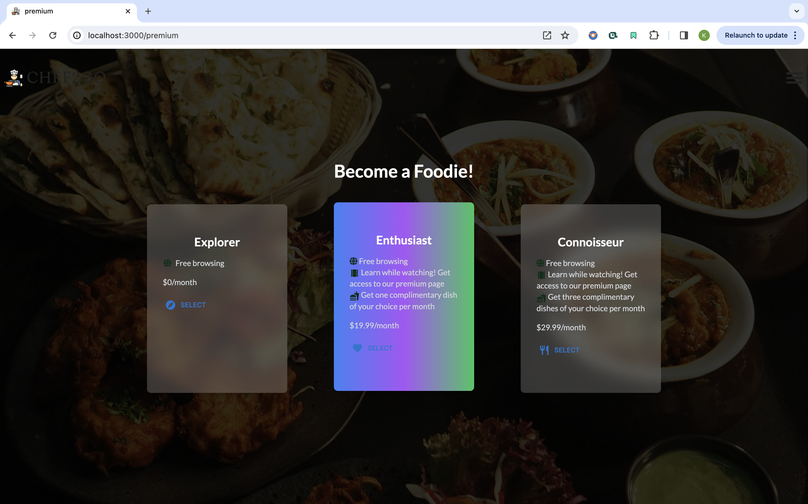
PREMIUM SUBSCRPTION PAGE

Slide 16
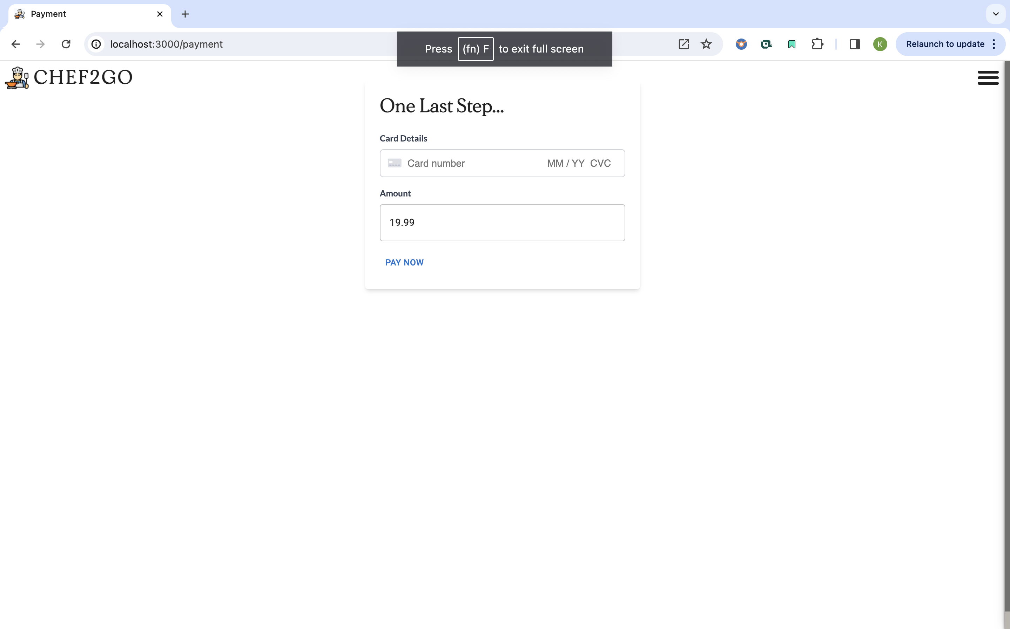
PAYMENT PAGE

Slide 17
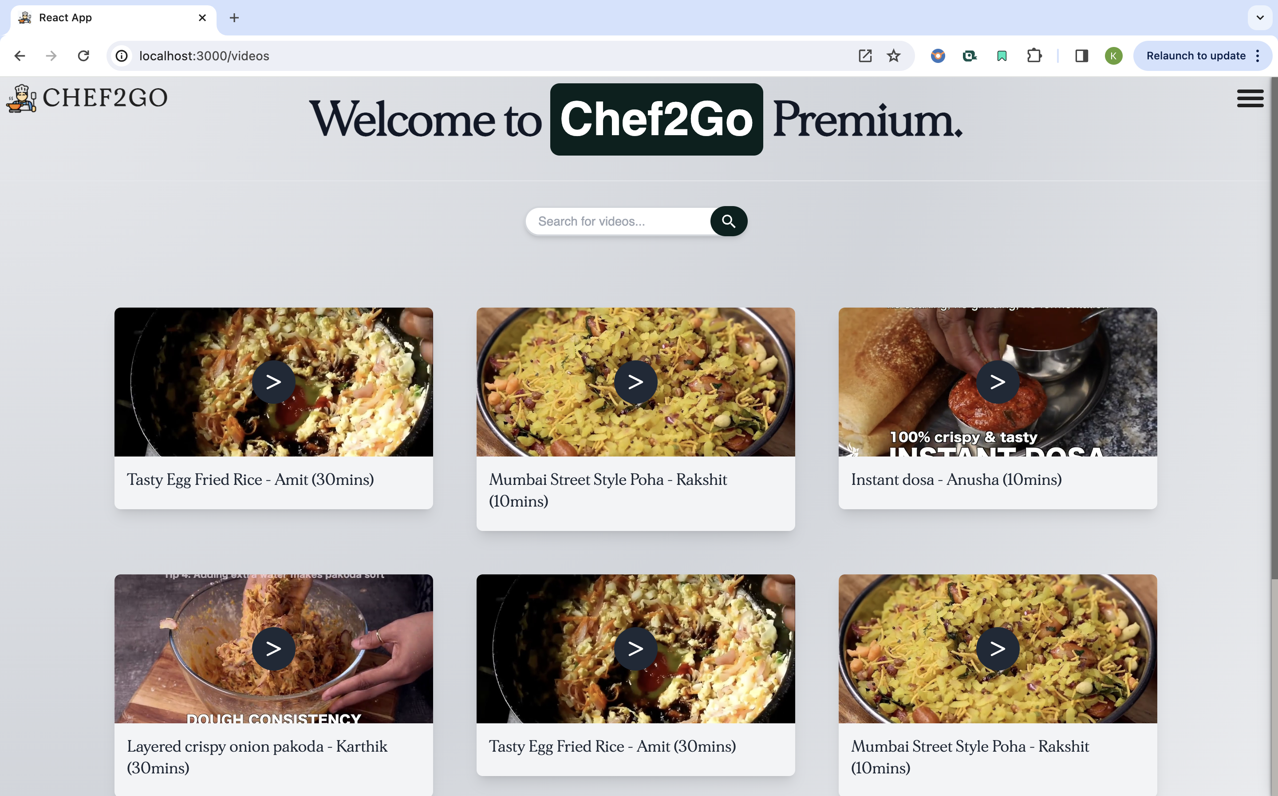
PREMIUM VIDEOS PAGE

Slide 18
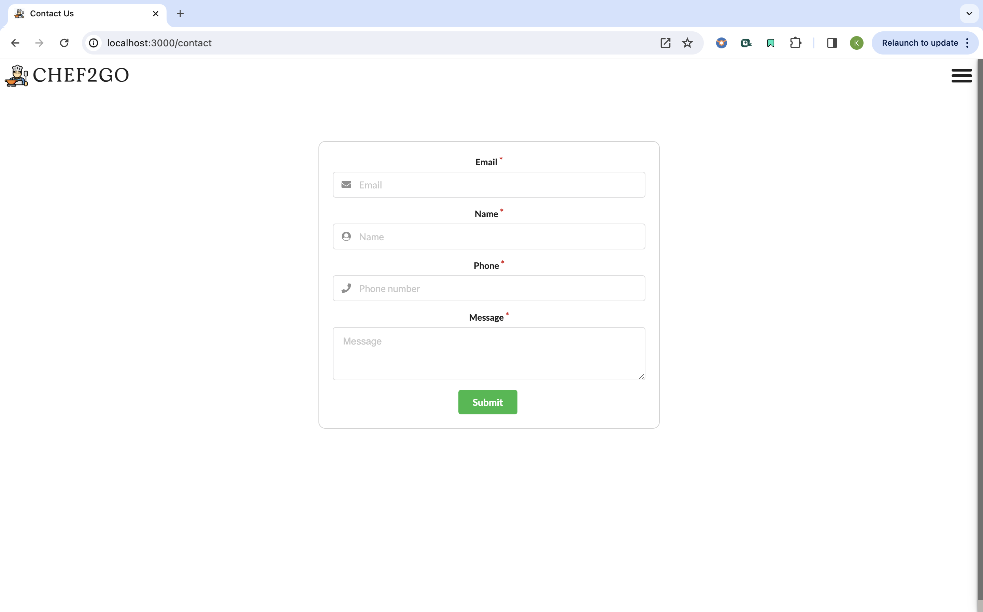
CONTACT US FORM

Slide 19

Contributions
Basavaraj: All frontend and backend part associated with Home Page, User registration/login, User proﬁle and navigation bar
Bhuvan: Individual Recipe Page, AddRecipe, signup, login, admin UI, comments API, PWA, Router setup
Shreyas : All frontend and backend part associated with Premium Subscription, Videos and Payments
Keerthana : All frontend and backend part associated with Search By Recipe, Search by Chef, About US, Contact US Form and Localization

Slide 20
References:
https://mui.com/material-ui/Documentation
https://tailwindcss.com/

